Slide 1
Alaska Hatchery Research Project Science Panel Meeting, January 19, 2021 Chum Maturation Age: Brood year 2017 returns in 2022
Lorna Wilson
Private Non Profit Hatchery Assistant Program Coordinator
Alaska Department of Fish and Game

Slide 2
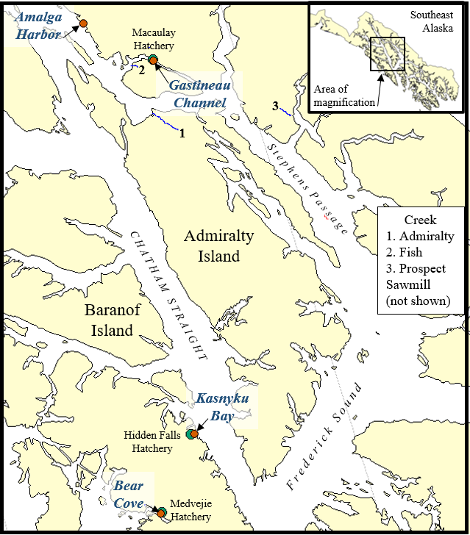
Chum return projects
DIPAC
Gastineau
17,399,561 chum returns, 2002-2021
Mean n (year, age) = 228,942
Amalga
26,554,231 chum returned 2001-2021
Mean n (year, age) = 331,928
NSRAA
Hidden Falls
22,522,683 chum returns, 2001-2021
Mean (year, age) = 268,127
Medvejie
26,554,231 chum returns, 2009-2021
Mean n (year, age) = 330,448
N

Slide 3
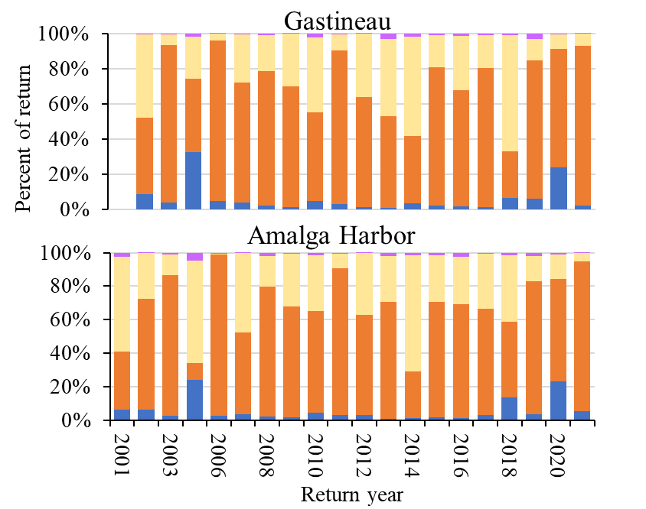
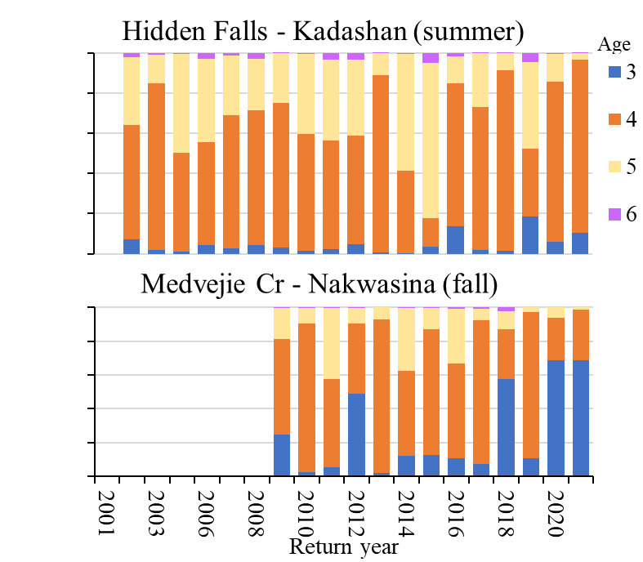
Return year
Notes:
5-year-olds were 4-7% of the 2021 return

Slide 4
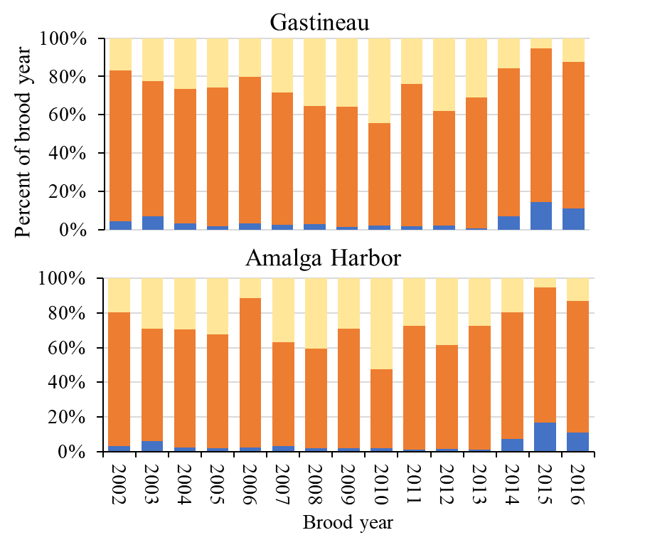
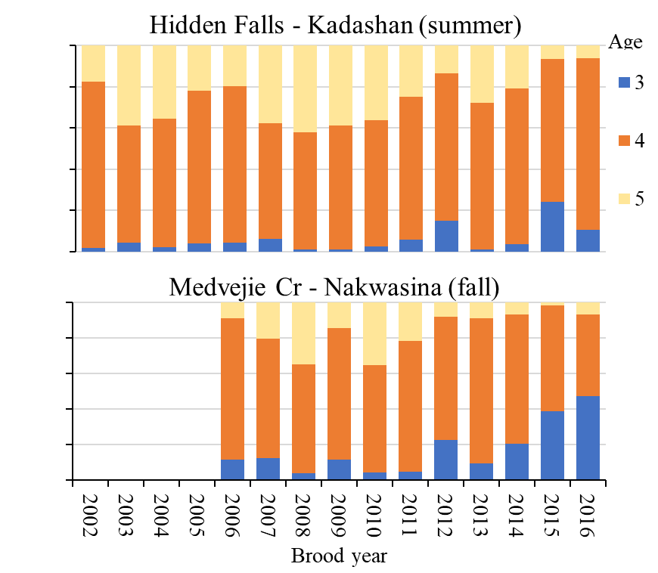
Brood year
Notes:
Only ages 3, 4, and 5
5-year-olds were 6-13% of brood year 2016

Slide 5
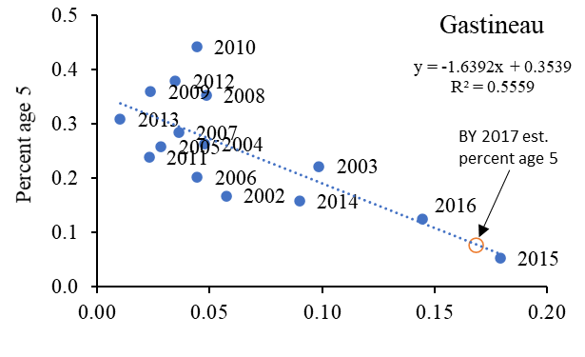
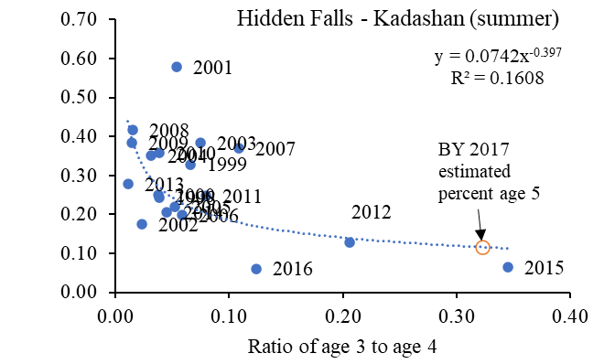
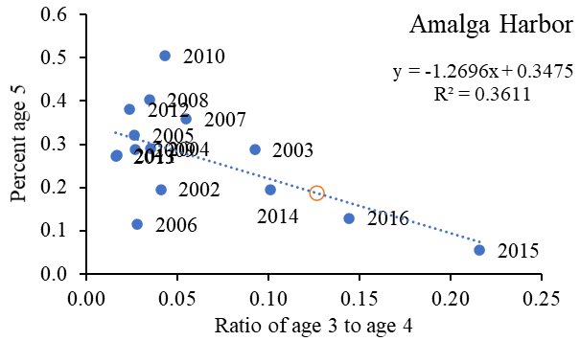
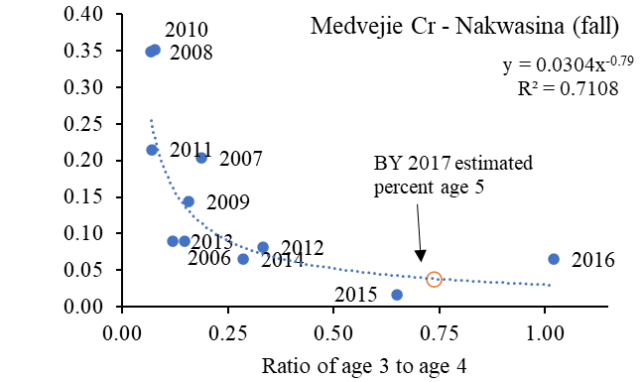
Age 3:4 to age 5
Notes:
Expect Gastineau channel BY17 chum to be 8% age 5,

Slide 6
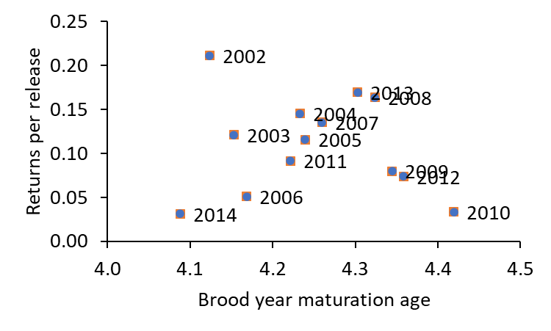
Guess for brood year 17 returns in 2022
Expect 36,295 age 5 chum returns to Gastineau.
In 2021,
28,862 age 5 chum returned to Gastineau
32 age 5 marked otoliths recovered from Fish Cr.
Dome shape? Max. returns at ~age 4.25?

